Slide 1
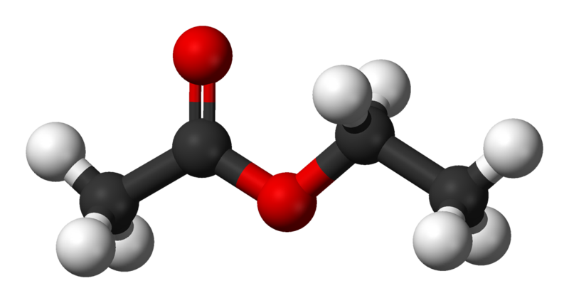
Esters
April 2022

Slide 2
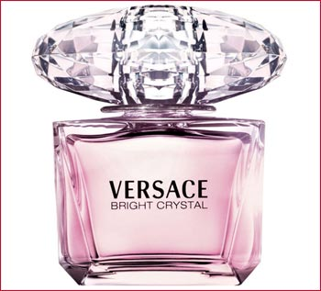

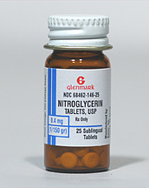
Esters:
Carboxylic acid derivatives: when you react a carboxylic acid and an alcohol you get an ester.
Esters are everywhere!
Most naturally occurring fats are fatty acids esters of glycerol. (More on this later)
Esters with low molecular weight are commonly used as fragrances and found in essential oils and pheromones.
Nitrate esters, such as nitroglycerin, are known for their explosive properties.
Polyesters are important plastics.

Slide 3
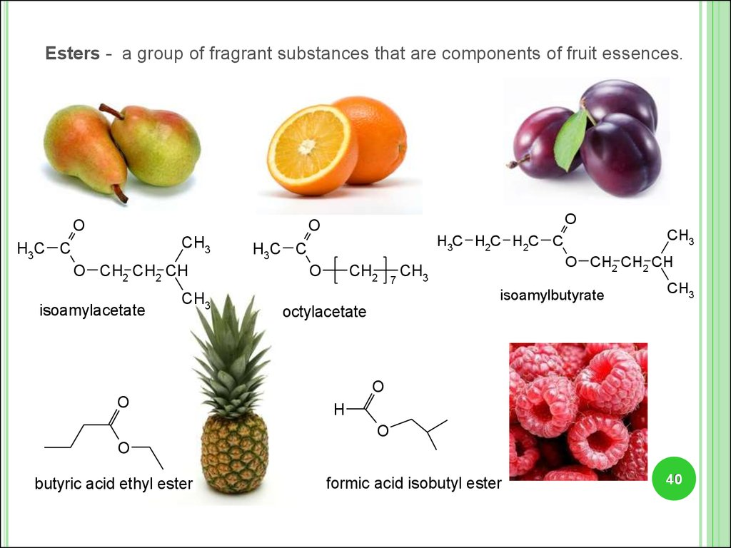

Slide 4
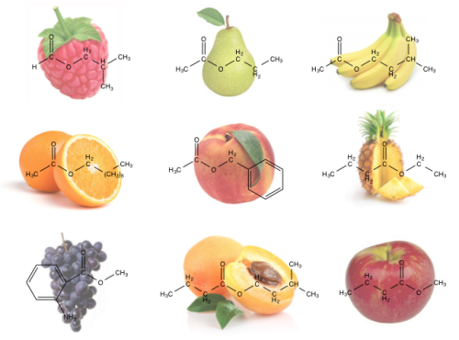
https://breakingdownchemistry.tumblr.com/post/74317479432/why-fruits-smell-the-way-they-do-the-smells-of

Slide 5
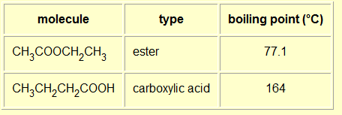
Physical properties of esters
Small esters have boiling points similar to those of aldehydes and ketones with the same number of carbon atoms.
Esters are POLAR molecules.
They don’t form hydrogen bonds with each other.

Slide 6
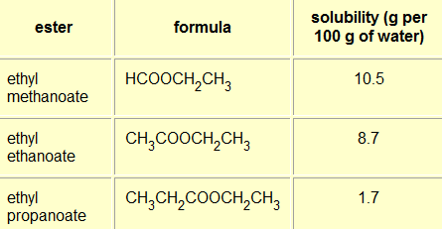
Physical properties of esters
Solubility:
Small chain esters are soluble in water, solubility lowers as the carbon chain increases.
Hydrogen bonds can be formed between an ester and water molecules

